Slide 1


Number Talk at Charborough Road Primary
Intent: Through the use of Number Talk, we aim to develop pupils’ fluency of number, so that they can use appropriate mathematical vocabulary, apply this knowledge to other aspects of maths and explain their reasoning.
‘Number Talk’ is a teaching strategy that focuses on developing pupils’ fluency, deepening their understanding of numbers, the connections between them and other concepts. It works on supporting pupils to become efficient, accurate, and work flexibly at the same time developing pupil’s mathematical vocabulary and reasoning skills. Number Talk is about pupils talking strategies rather than always recording maths or using one specific strategy. It’s not about as rapid response but about allowing pupils’ time to calculate an answer, explain their strategies, challenging each other, building on what they know and refining methods.

Slide 2
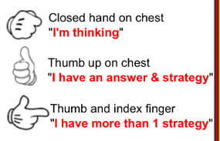
The session is separate from the daily maths session but the question stems and hand signals are used throughout all maths lessons and stem sentences are key. The session is about 5-15 minutes daily and starts with a problem written on the board. The children show what they are thinking using the following signs:
Here are examples of number talk in action across the school...

Slide 3
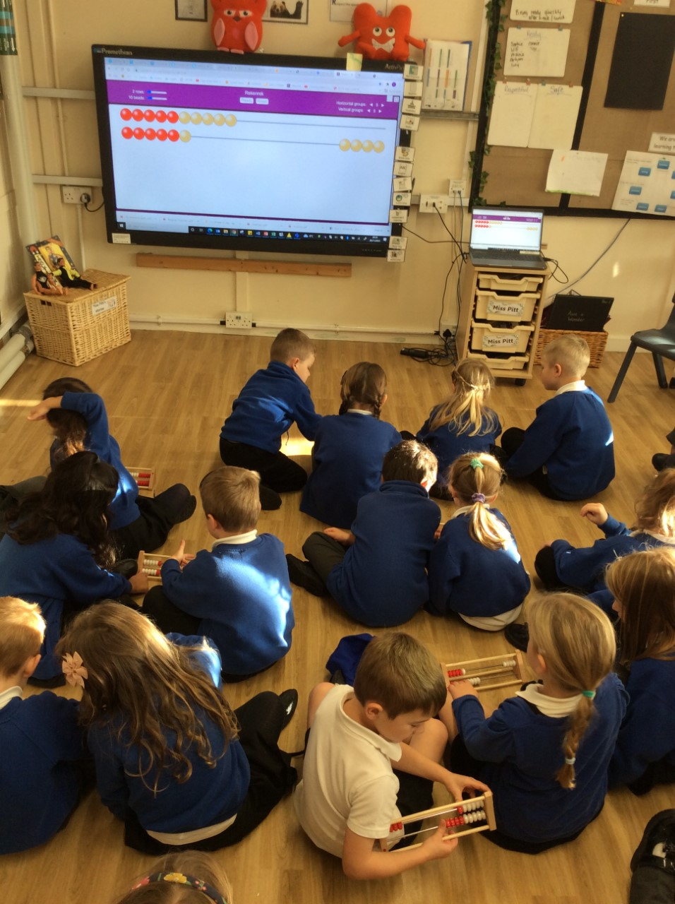
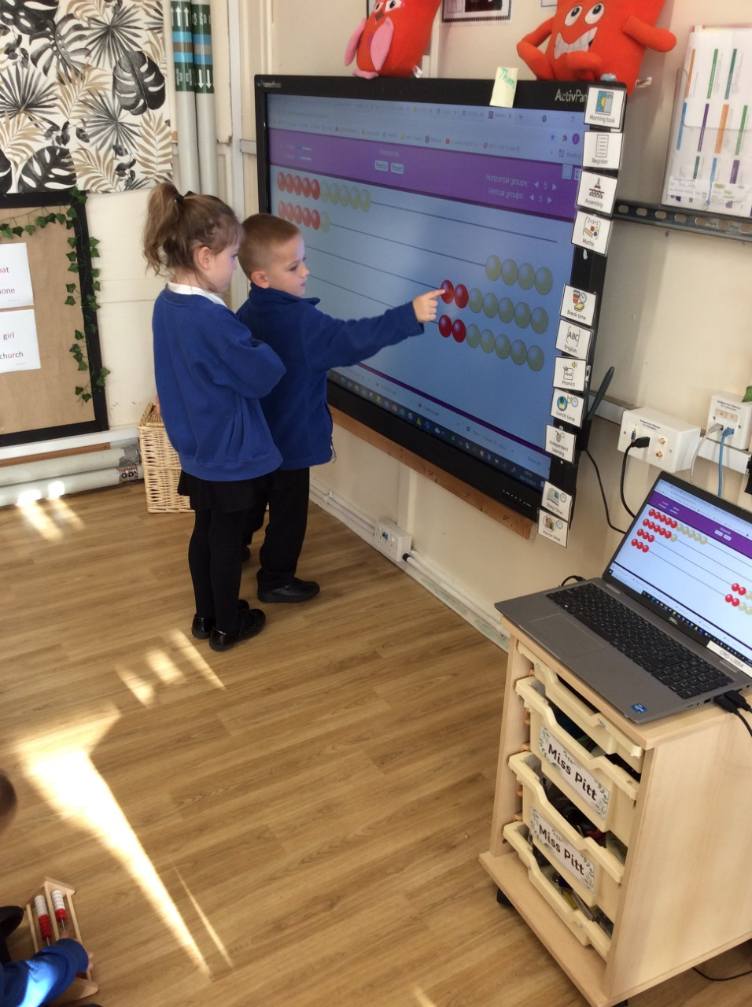
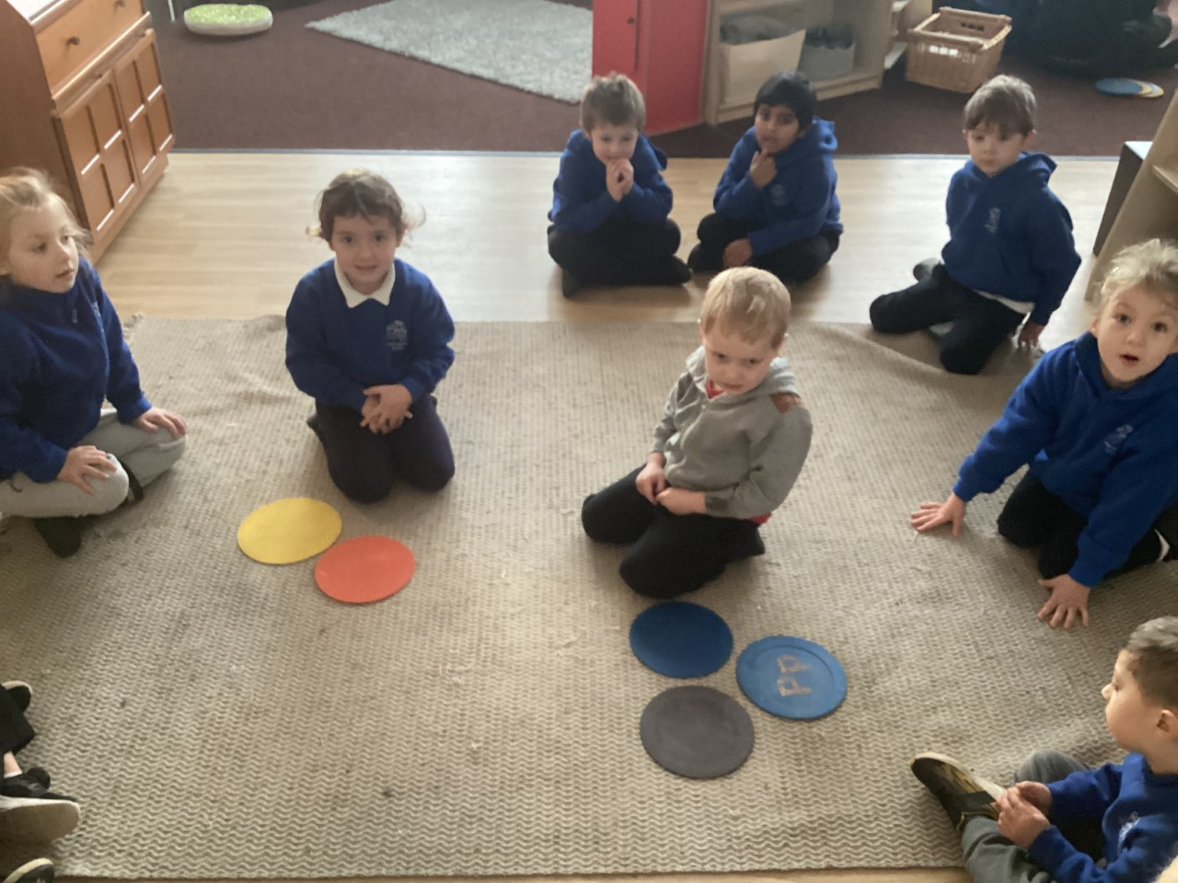
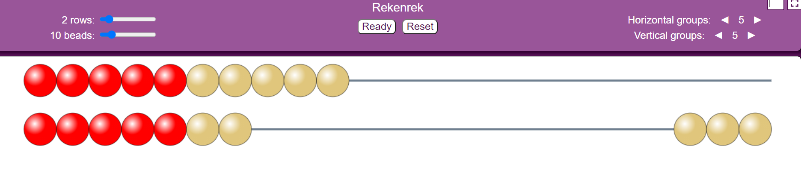

Number Talk in EYFS and KS1
How many ways dots are there?
How did you count the dots?
What number have I made? How can I make this number?
Notes:
Current EYFS – Jo.

Slide 4
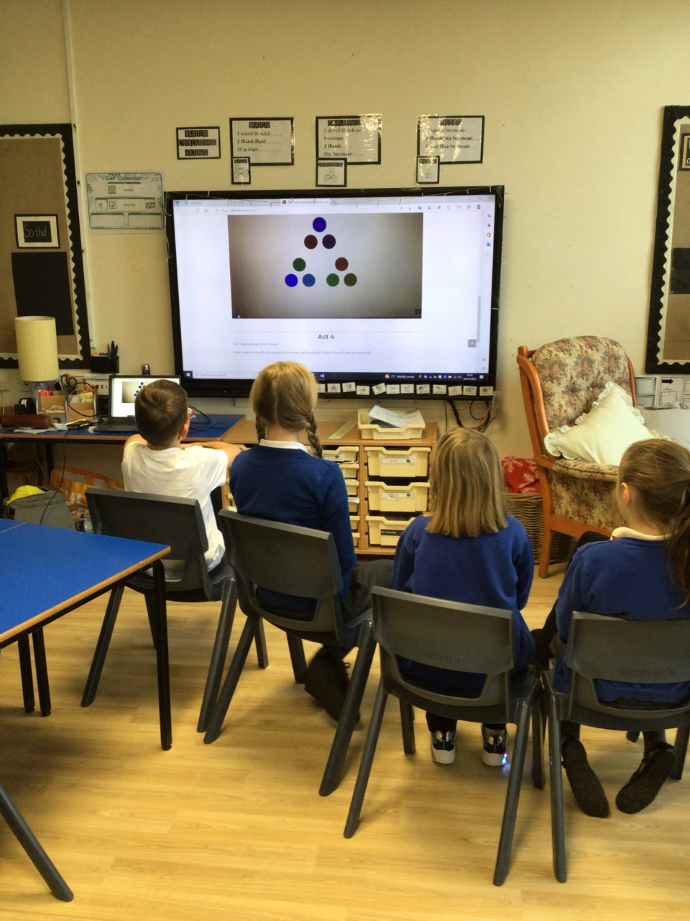
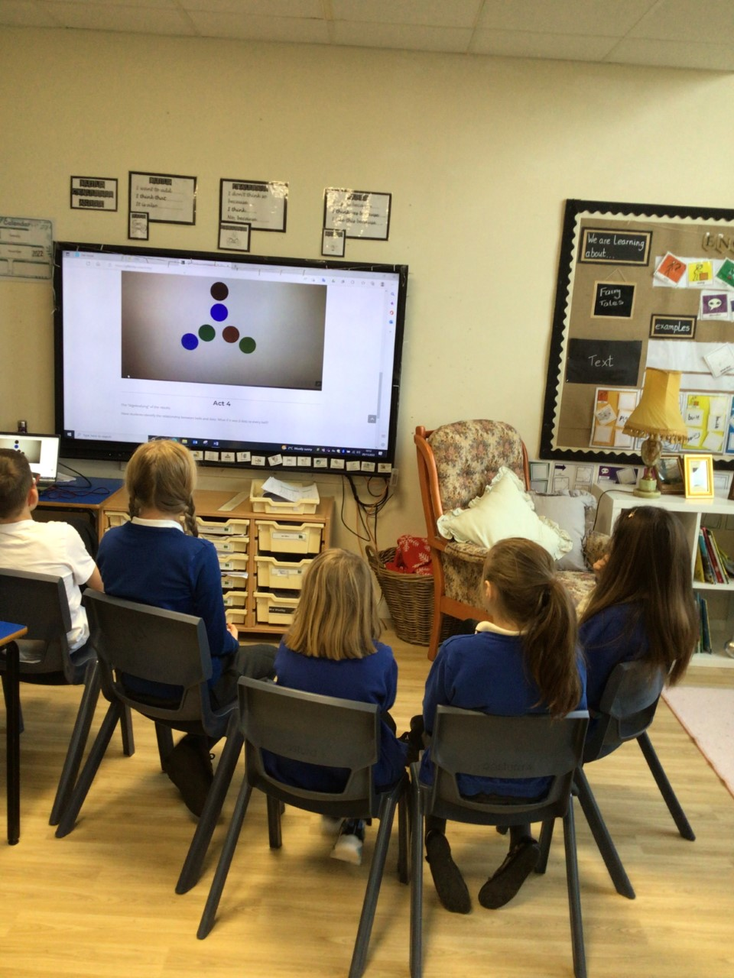
Number Talk in Resource Base
How could you count the dots? Show me another way.

Slide 5
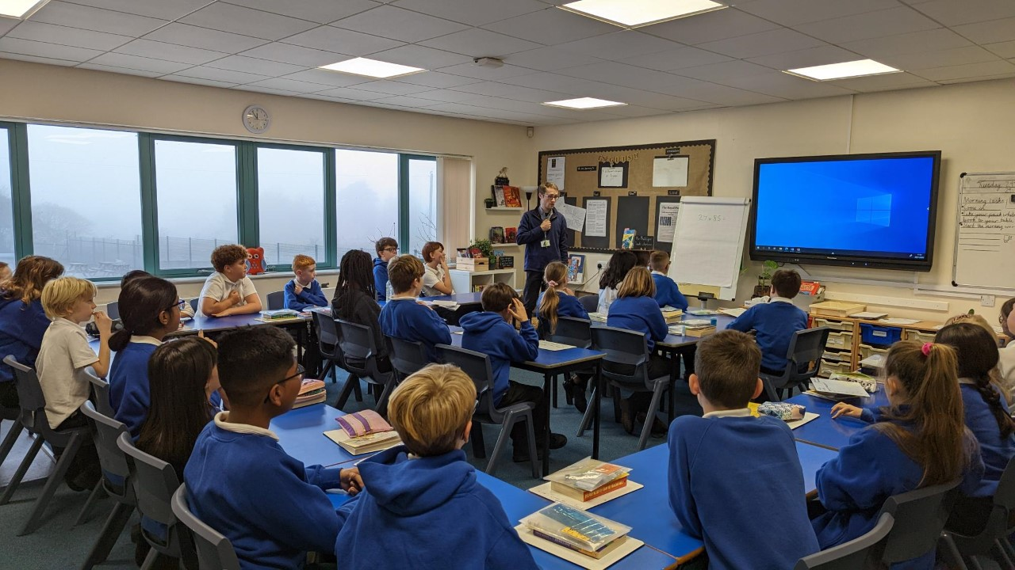
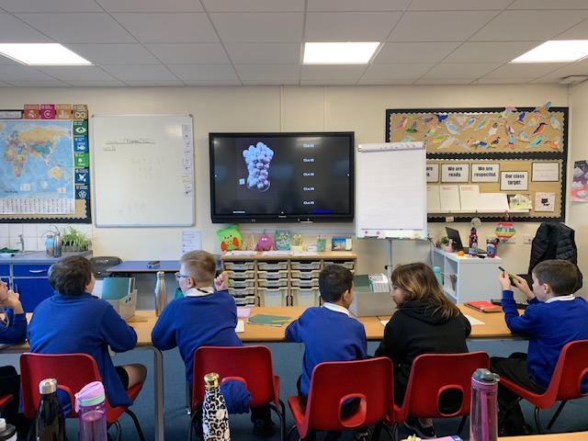
Number Talk in KS2
How many ways can you solve the following calculations mentally? Which method is effective and why?
9 – 2.7 =
9.54m + 2.03m =
3.63 + 2.13 =
Notes:
Y4

