Slide 1
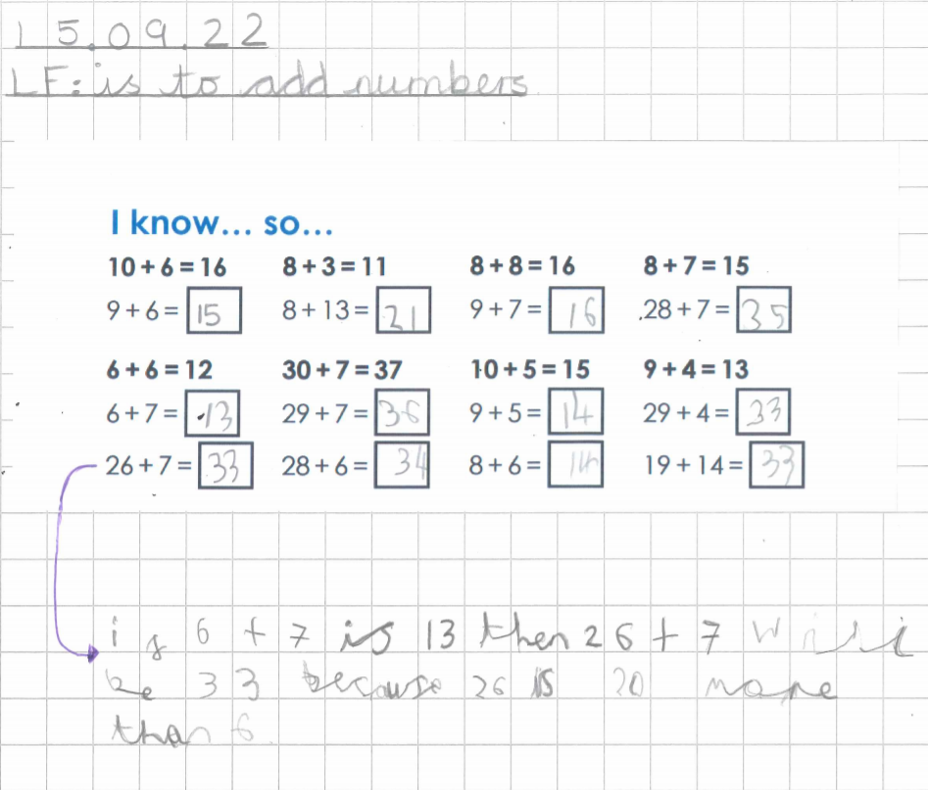
Strategies we use to foster deeper thinking in Maths.
1
INTELLIGENT PRACTICE
In fluency, we provide children with sequences of questions using key principles from Variation Theory. Children are asked to look at what is the same and what is different between each questions. This encourages them to make mathematical conjectures and predictions.
Notes:
Y3 and Y6

Slide 2
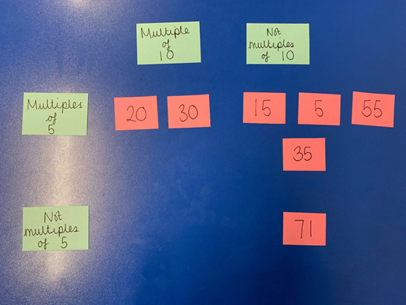
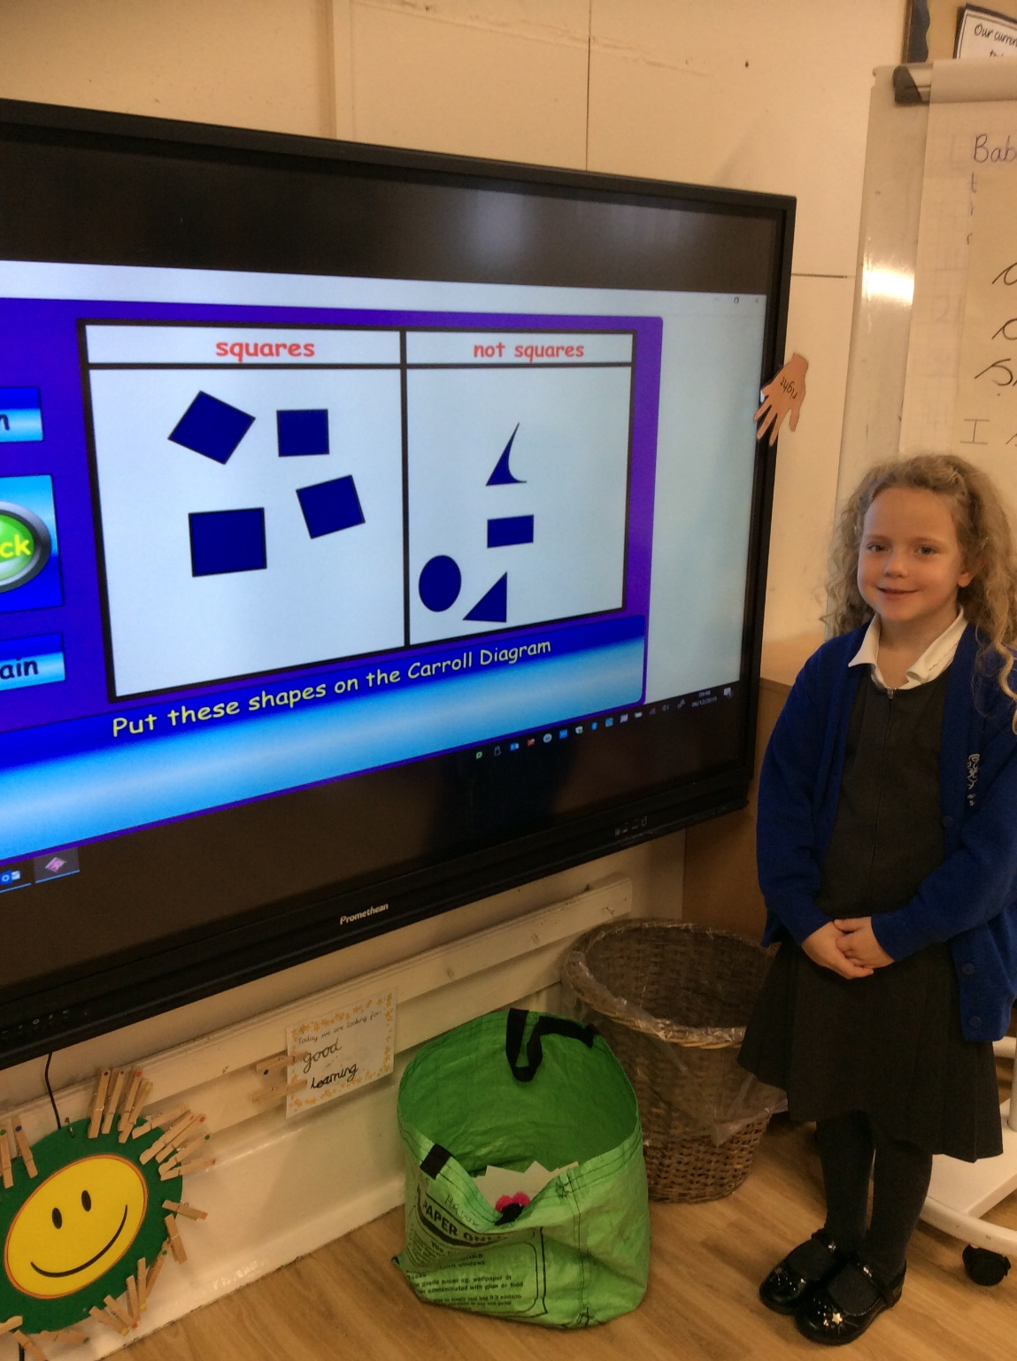
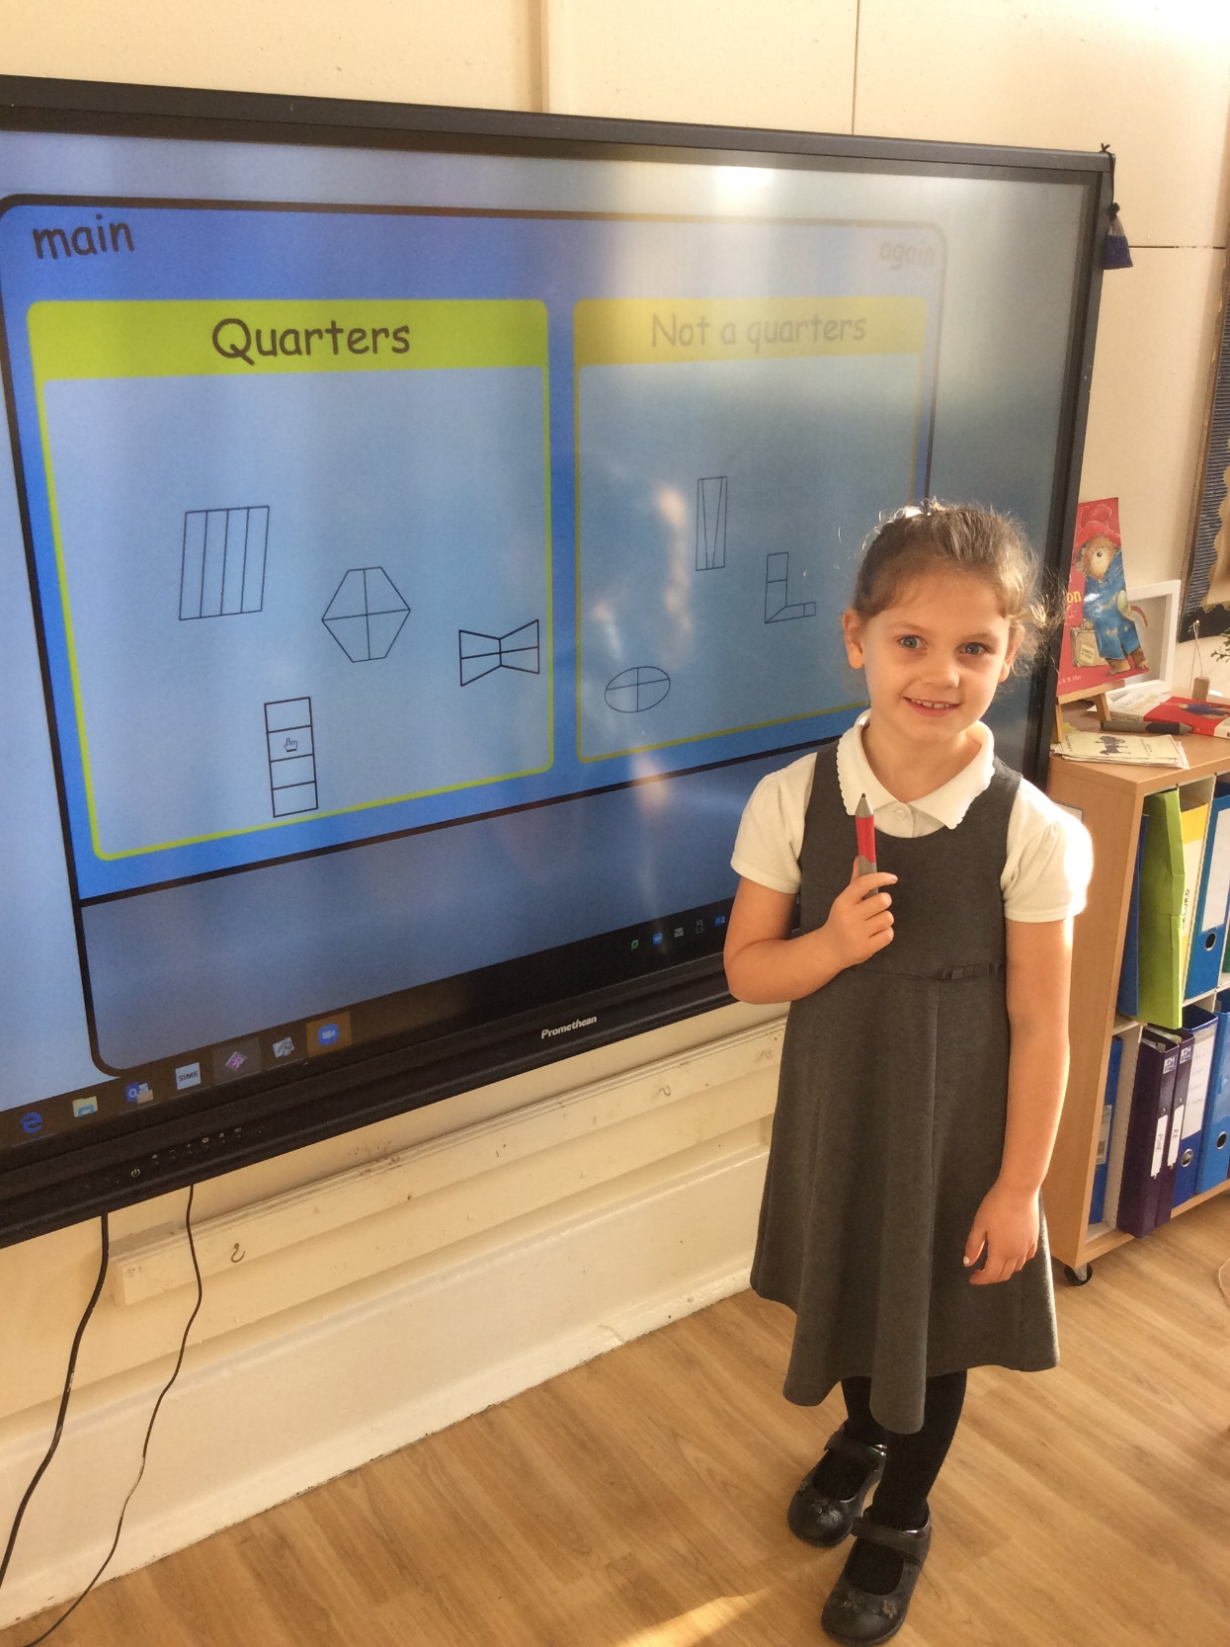
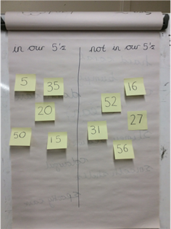
Strategies we use to foster deeper thinking in Maths.
‘Non-examples are a really good way of pre-empting common misconceptions and giving students unambiguous definitions and explanations’ Jo Morgan.
2
EXAMPLE AND NON EXAMPLE

Slide 3
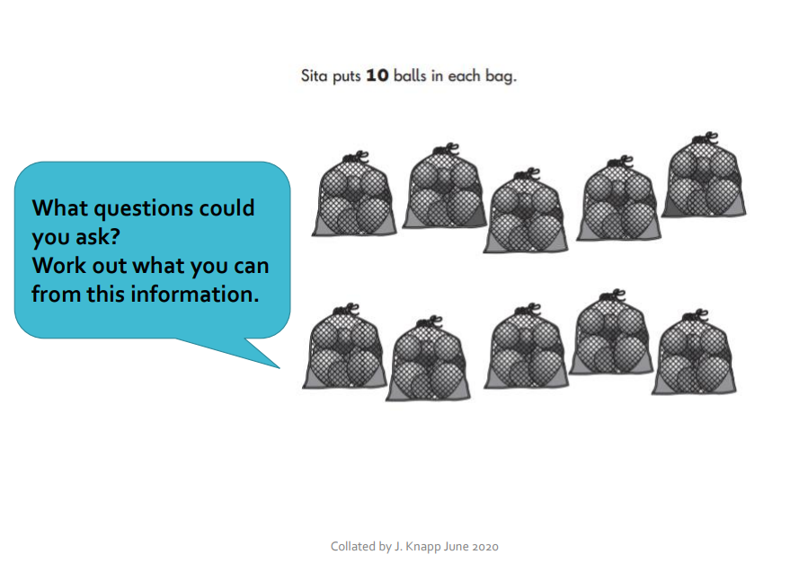
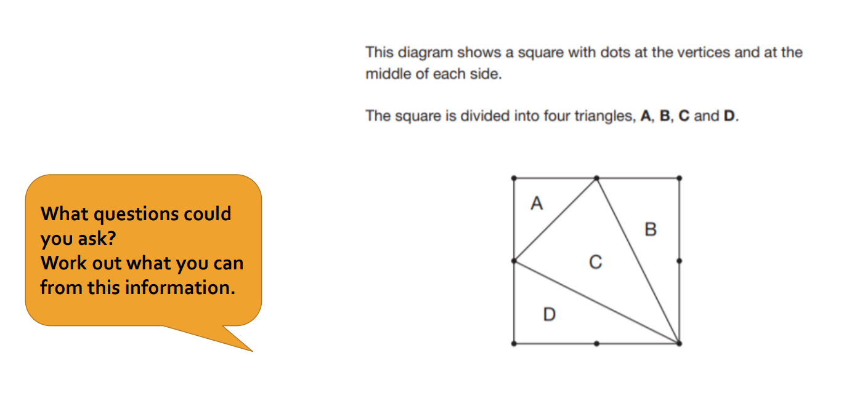
Strategies we use to foster deeper thinking in Maths.
3
GOAL FREE PROBLEMS
‘Goal free questions are the longer two or three-part reasoning questions that appear in maths, not simple calculations, and they are best used once you have taught the children something and now want them to apply it in a problem-solving context’. Clare Sealy.

Slide 4
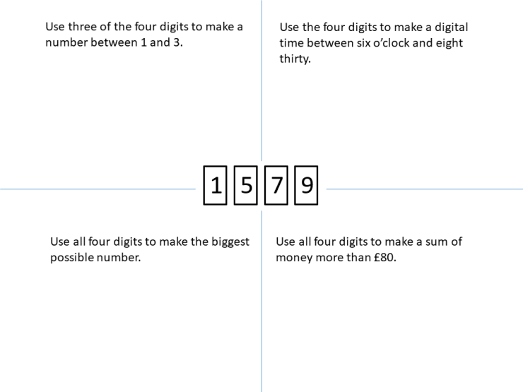
Strategies we use to foster deeper thinking in Maths.
‘SSDD problems are a set of problems that may look the same at first glance, but which require different mathematical ideas to solve them’ Craig Barton, 2020. This encourages the children to retrieve prior learning and make links between topics in maths.
4
SAME SURFACE DIFFERENT DEPTHS

Slide 5
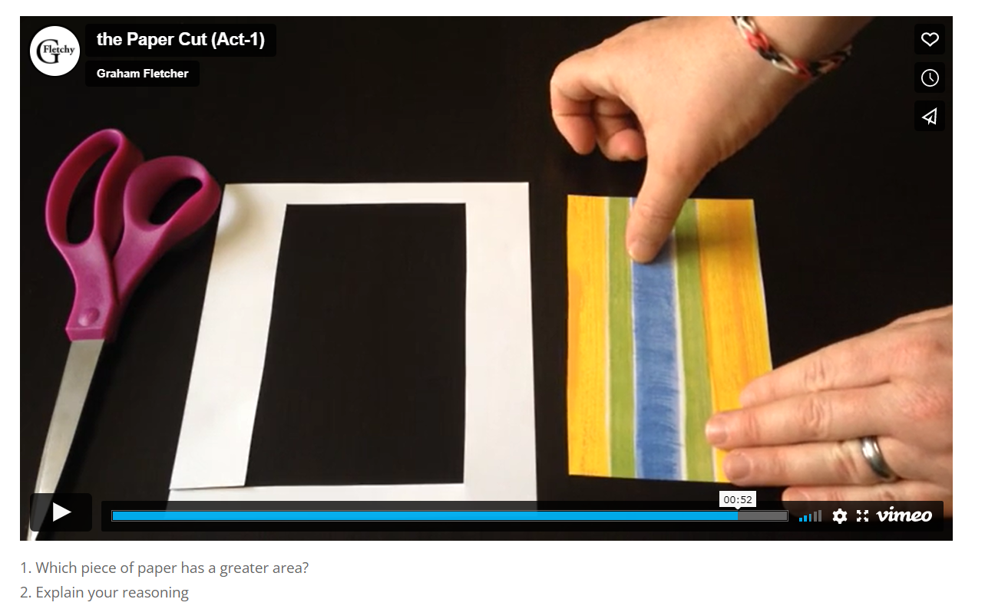
Strategies we use to foster deeper thinking in Maths.
‘Act 1 shows the context for the enquiry and allows children to generate questions - what do they wonder? What extra information do they need? In act 2, more information is provided; children are then given the chance to speculate and calculate before the solution is revealed in act 3!’ Gareth Metcalfe.
5
3 ACT TASKS

